Slide 1
Data Analysis for Simulated Traffic Data

Slide 2
Overview
This presentation covers following topics:
Reasons for data preprocessing and its most common techniques
Explanation of used statistical characteristics
K-Means clustering algorithm
Regressions

Slide 3
Data Preprocessing
Data preprocessing is a process of converting raw data into a clean data set ready to be used in analysis.
Raw data usually has one or more following characteristics:
It is partial, meaning that there is a need to combine several data sources or data sets into one.
It is not consistent. The data describing same phenomena can be different in different data sources.
It has missing values.
It is saved in a format not suited for further analysis.

Slide 4
Data Preprocessing (cont.)
Data Preprocessing tries to solve the problems raw data contains:
Aggregation. Aggregation involves either combining several data sets into a single on or combining several features into one. The whole idea is to combine things into meaningful entities. Examples: combining data from several different sensors into a single dataset; grouping temperature measurements into average of 5 minutes intervals.
Imputation. Imputation is used for filling in missing values. Depending on the nature of the data with missing values and applications you have several methods to chose from: filling with zeroes, filling with previous values, linear interpolation, filling with sample mean values and many others.

Slide 5
Data Preprocessing (cont.)
Restructuring. Restructuring is used for changing the shape of a dataset, which might be needed for some algorithms. It may involve transpose, row/columns shifting, separation and many others operations.
Scaling. A lot of algorithms might not be able to achieve optimal performance if any at all without a proper scaling. Scaling is always needed if different variables in the dataset have completely different units and magnitudes. For example, it is fine to leave dataset with unscaled if it contains couple of room temperatures from the same building as they are going to have more or less similar ranges. And it is absolutely not fine if you have energy consumption, pressures and temperatures in the same dataset, because the variables will have completely different units and ranges, some of the algorithms can completely neglect temperature as its range cab be so small compared to other variables. Good rule of thumb: if the orders of magnitudes of variables are same, then scaling is not essential, but can still be benefitial.

Slide 6
Data Preprocessing (cont.)
Categorization. If some variable can only assume certain values, then this variable can be considered categorical. Categorical variables are important, because they can be used for dataset separation and classification. Sometimes, you might want to artificially create such variables: the most common way is either clustering or categorization based on aggregation (grouping) of some other variable in the data set.

Slide 7
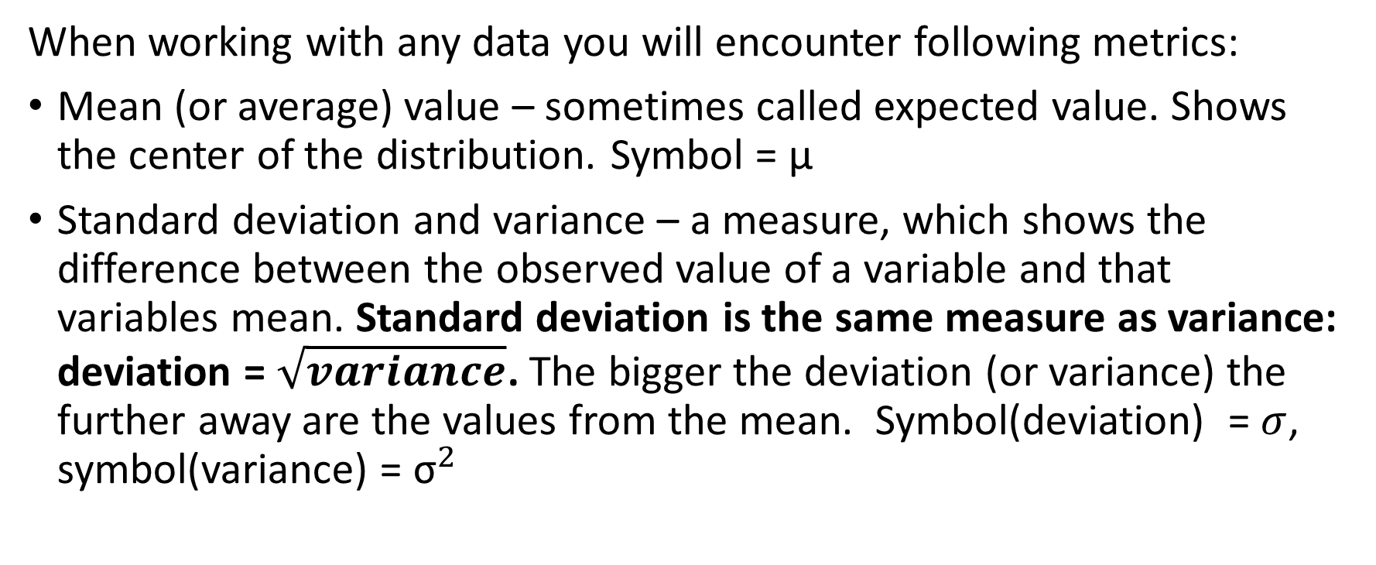
Most important statistical parameters
When working with any data you will encounter following metrics:
Mean (or average) value – sometimes called expected value. Shows the center of the distribution. Symbol = µ
Standard deviation and variance – a measure, which shows the difference between the observed value of a variable and that variables mean. Standard deviation is the same measure as variance: deviation = $\sqrt{variance}$. The bigger the deviation (or variance) the further away are the values from the mean. Symbol(deviation) = $σ$, symbol(variance) = ${\text{σ}}^{2}$

Slide 8
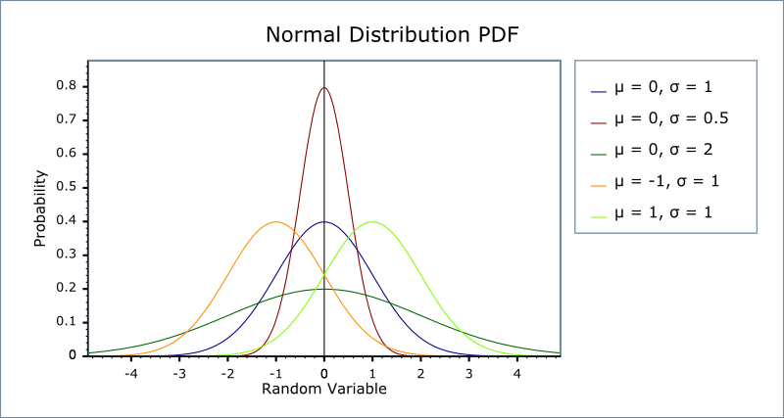
Form of normal distribution, depending on mean and deviation.

Slide 9
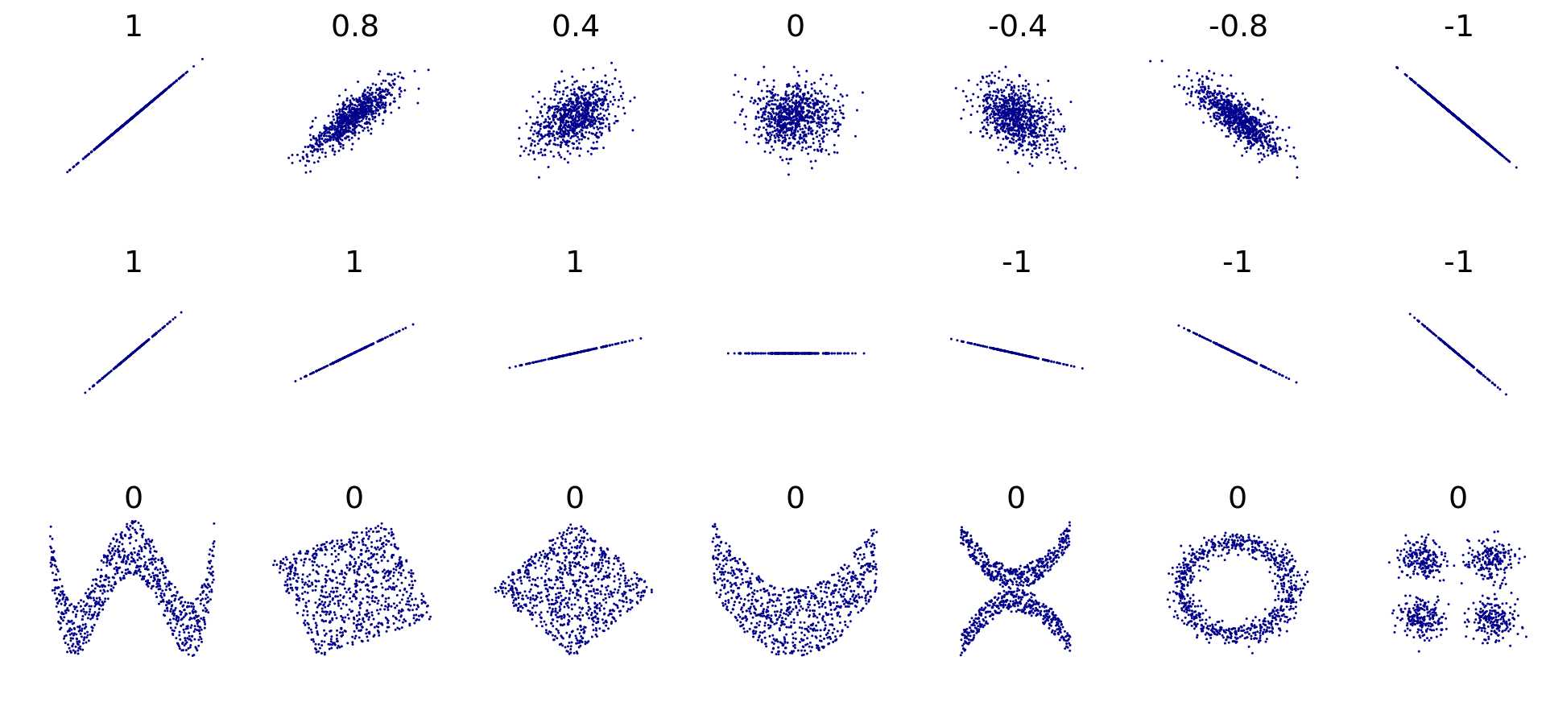
Most important statistical parameters
Correlation – degree to which a pair of variables are linearly related. The figure below shows, how it is usually represented in the real life. Note that correlation cannot show nonlinear dependencies.

Slide 10
k-Means clustering
k-Means clustering is a type of unsupervised learning, which is used when you have unlabeled data (i.e. data without defined categories or groups). The goal is to find groups in the data.
Applications:
Pattern recognition
Automatic data labeling
More information: https://www.datascience.com/blog/k-means-clustering

Slide 11
Regression
Regression is an approach to modelling the relationship between a dependent variable and one or more independent variables.
Regression models are used in the following scenarios:
Estimation of some variable, based on some other variables.
Forecasting
Evaluating dependencies between different variables.
Regression is a supervised machine learning technique, meaning you need a labeled dataset in order to use it.

